Slide 1
Phases of Methods Engineering

Slide 2
Planning
Identifying and understanding the problem & setting the objectives
The problem may be:
low productivity,
high cost,
inefficient methods
The objective is the desired improvement or new method design.
Possible objectives are to increased productivity, reduced labor content and cost, improved safety, or developed new method or new operation.

Slide 3
Planning -2
Invariably the most profitable jobs to study are those with:
the most repetition,
the highest labour content (human work as distinguished from mechanical or process work),
the highest labour cost,
or the longest life span.

Slide 4
Methods Study
Analyze the Problem
Collect data on the problem being studied & analyse activities
Activities often used in this step include the following:
Identify the basic functions of the operation.
Gather background information.
Observe the existing process or observe similar processes
Collect data on the existing operation and document the details in a format that provides itself to examination.
Conduct experiments on the process.
Develop a mathematical model of the process or utilize an existing mathematical model
Perform a computer simulation of the process.
Use charting techniques.

Slide 5
Methods Study -2
Formulate alternatives
There are always multiple ways to perform a task or accomplish a process, some of which are more efficient and effective than others.
The purpose of this step is not to identify the best alternative but to formulate all of the alternatives that are feasible.
Evaluate Alternatives and Select the Best.
This step consists of a systematic assessment of the alternatives and the selection of the best solution among them, based on the original definition of the problem and objectives.

Slide 6
Standardisation
Implement the Best Method:
introducing the changes proposed in the existing method or operation,
or installing the new method or process.
This may involve:
pilot studies or trials of the new or revised method
training operators to follow the new standard methods
complete documentation of the new or revised method and
replacement of the previous documentation

Slide 7
Control
Perform an audit or follow-up on the methods engineering project.
How successful was the project in terms of the original problem definition and objectives?
What were the implementation issues?
What should be done differently in the next methods engineering study?

Slide 8
Techniques of Methods Engineering
Process Chart Analysis
Operations Analysis
Motion study and work design
Facility layout planning
Work measurement techniques

Slide 9
Process Chart Analysis
A process chart is a graphic representation of events occurring during series of actions or operations that form a methods.
Operations process chart
Flow process chart
Flow diagram
Operator process chart or left-hand/right hand chart
Man and machine chart
Simo chart
Gang process chart
Multi-activity process chart
Travel chart or from-to-chart

Slide 10
Exercise
These charts are used under different conditions, depending on the investigations or analysis being undertaken.
The Method Analyst therefore needs to be familiar with all of these charts in order to use them appropriately.
Assignment
Choose two of the charts, write a brief description of them and what they are used for. Also, make a drawing of a typical example and explain the method taking place.

Slide 11
An Example: Operations Process Chart
The operation process chart shows the chronological sequence of all operations, inspections, time allowances, and materials used in a manufacturing or business process, from the arrival of raw material to the packaging of the finished product.
It is particularly useful in connection with plant layout studies.

Slide 12
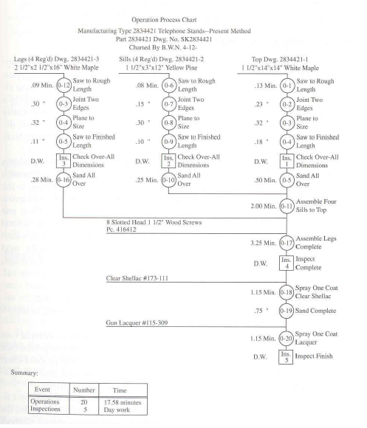

Slide 13
FLOW PROCESS CHART
The flow process chart is a tool for recording a process, with the intent to understand it better and improve it.
represents graphically the separate steps or events that occur during the performance of a task or doing a series of actions.
The chart usually begins with the raw material entering the factory and follows it through every step.
D
Transportation
Operation
Delay
Inspection
Storage

Slide 14
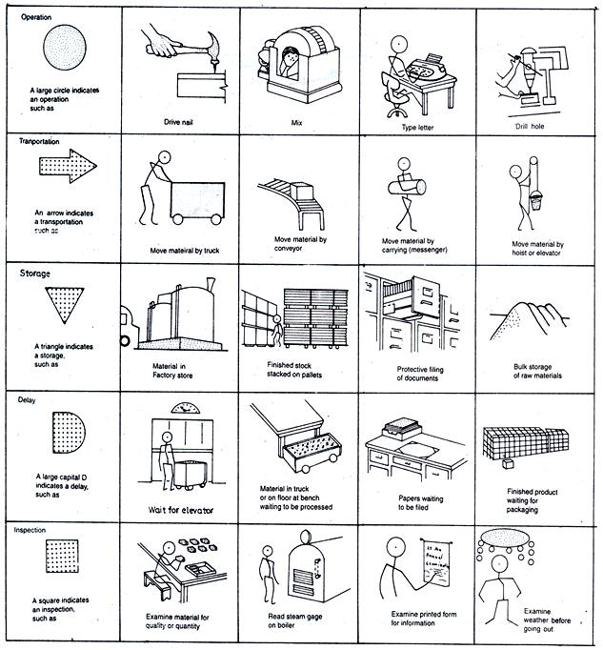

Slide 15
Operations Analysis
There are 10 major considerations of operations analysis that are applied in methods study:
Purpose of operations
Design of part
Tolerances and specification
Material
Process of manufacture
Set up tools
Plant layout
Work conditions, and
Motion and time study

Slide 16
Motion Study
Two approaches to motion study:
Macro motion study: This is the study of the overall product flow through the manufacturing facility
Micro motion study: This is used to understand individual operations using techniques that enable an understanding of the smallest detail of each operation so improvement can be made.

Slide 17
Macro Motion Study
-Defined as the flow of a product as it moves through the factory.
It makes use of the five process chart symbols we looked at before: delay, operation, transportation, inspection and storage.
Techniques for Macro Motion Study
Flow diagram
Operations Chart
Flow process chart
Works cell load chart
Route Sheet

Slide 18
Micro Motion Study
-Looks at the study of individual operations
-Operations or work is broken down into motions like :
Reach,
Move,
Grasp,
Position,
Align etc
-Time it takes to undertake each activity is measured.
Gilbreth concluded that any work can be done using a combination of 17 basic motions, called Therbligs.
The breaking down of operations into individual motions, including delay in the process helps to identify inefficient motions and to utilise or eliminate even split-seconds of wasted time.

Slide 19
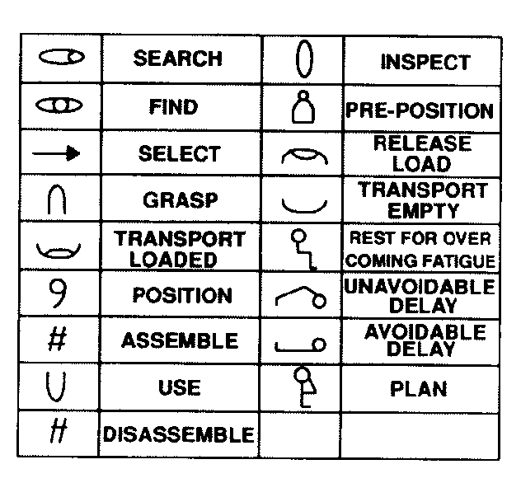
Therbligs

Slide 20
Some Micro Motion Study Techniques
Operations analysis chart –used to describe a single activity
Operator/machine chart – used for two activities
Gang chart- used when two or more people work together,
Multi-machine chart
Left-hand/right-hand chart – for one operator, treats each hand as an activity
NB: Techniques have some factors in common which include:
-each activity is broken down into elements;
-Time is measured linearly in minutes.
All operations analysis techniques can use the same form but the
number of activities varies.

Slide 21
Standardisation and Operator Training
After standardisation, it is imperative that equipment, materials and working conditions be standardised to ensure that the proposed methods is followed at all applicable work centers.
It is very important to train the operator
Depending on the nature of the job, training can consist of:
Verbal instruction demonstrations at or away from the from the workplace,
Written instruction cards,
Visual guidance with video tapes or motion pictures,
Or a combination of these and other training techniques.

Slide 22
Labour Standards and Work Measurements
The number of standard hours in which operators, working on standardised job or working with standardised method is determined by measurement.
Labour standards (time standards) are the amount of time required to perform a job or part of a job.
Labour standards help to determine:
labour content of items produced (the labour cost)
Staffing needs of organisations
Production expected
Basis of wage-incentive plans
Cost and time estimates
Labour or time standards will let employers know the amount of time it should take an average employee to perform specific job activities under normal working conditions

Slide 23
Setting Labour or Time Standards
Techniques used for setting time standards include:
Historical experience (relatively easy and inexpensive to obtain)
Time studies (Proposed by Taylor and most widely used)
Predetermined Time Standards (Prohibitively expensive)
Work sampling

Slide 24
Time Studies
It is often called the classical stop watch study
It involves timing a sample of a worker’s performance and using it to establish a standard .
Procedure:
Define the task to be studied (method analysis)
Break down the task into precise elements (parts of a task that often take no more than a few seconds
Decide how many times to measure the task (number of cycles or samples needed)
Time and record the elemental times and ratings of performance

Slide 25
Time Studies: Procedure Contd.
5. Compute the average actual cycle time
Average cycle time = sum of each elemental time measured
Number of cycles observed
6. Compute the normal time for each element- it is a measure of a performance rating for a particular worker pace observed (adjusts the observed time to what a normal worker could expect)
Normal Time = Average cycle time * performance rating
Sum the normal times for each element to develop a total normal time for the task.
Compute the standard time (it takes into account time for personal needs, unavoidable delays and worker fatigue)
Standard time = Total normal time
1 – allowance factor
Personal allowances are often established in the range of 4% to 7% of total time

Slide 26
Example 1
The time study of a work operation yielded an average actual cycle time of 4.0 minutes. The actual analyst rated the observed worker at 85% . This means the worker performed at 85% of normal time when the study was made. The firm uses a 13% allowance factor. Compute the standard time.

Slide 27
Example 2
Management Science Associates promotes its management development seminars by mailing thousands of individually types letters to various firms. A time study has been done on the task for preparing letter for mailing. On the basis of the observation below, Management Science Associates wants to develop a time standard for the task. The firm’s personal delay and fatigue allowance factor is 15%
Job Element | Cycle Observed (in minutes) |  |  |  |  | Performance Rating
 | 1 | 2 | 3 | 4 | 5
Type letter | 8 | 10 | 9 | 21 | 11 | 120%
Type envelop address | 2 | 3 | 2 | 1 | 3 | 105%
Stuff, stamps, seal and sort envelopes | 2 | 1 | 5 | 2 | 1 | 110%

